Slide 1


Quantum Autoencoder
EE4080 Final Year Project
Zhang Zeyu
School of Electrical and Electronic Engineering
Nanyang Technological University
May 9, 2020
Zhang Zeyu

Slide 2
Outline
Background
Part 1
Part 2
Zhang Zeyu

Slide 3
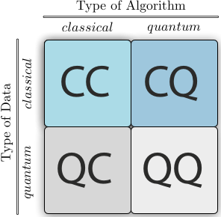
Background
[1]
Zhang Zeyu

Slide 4

Background
CC: Classical Machine Learning
Classical-Quantum (CQ) Machine Learning : exploit quantum algorithms to speed up classical machine learning tasks
Quantum-Classical (QC) Machine Learning : exploit classical machine learning techniques to improve quantum tasks
Quantum-Quantum (QQ) Machine Learning : exploit quantum computing devices to carry out learning tasks with quantum data
Zhang Zeyu

Slide 5
Background
CC: Classical Machine Learning
Classical-Quantum (CQ) Machine Learning : exploit quantum algorithms to speed up classical machine learning tasks
Quantum-Classical (QC) Machine Learning : exploit classical machine learning techniques to improve quantum tasks
Quantum-Quantum (QQ) Machine Learning : exploit quantum computing devices to carry out learning tasks with quantum data
Zhang Zeyu

Slide 6
Part 1: Compressive Quantum Autoencoder (CQAE)
Zhang Zeyu

Slide 7
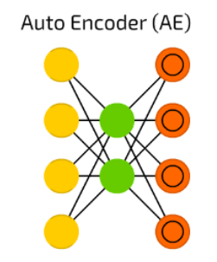




CQAE Classical Autoencoder
[2]
Zhang Zeyu

Slide 8
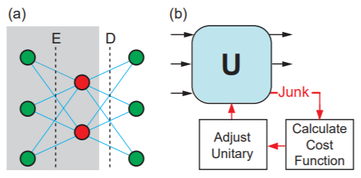
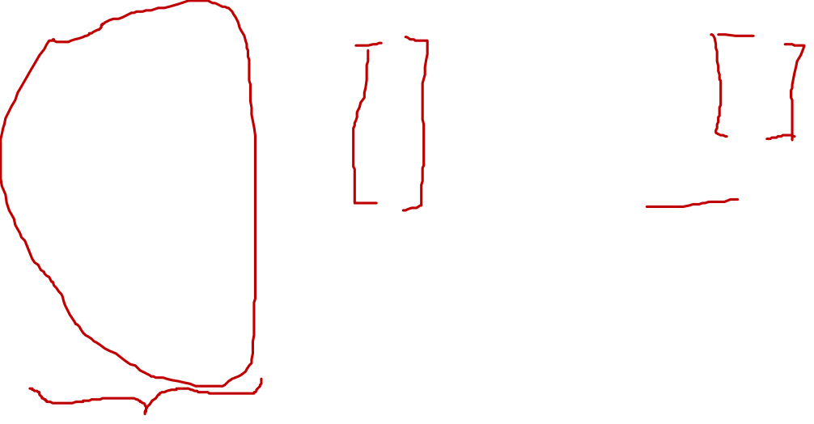
CQAE
[3]
Zhang Zeyu

Slide 9
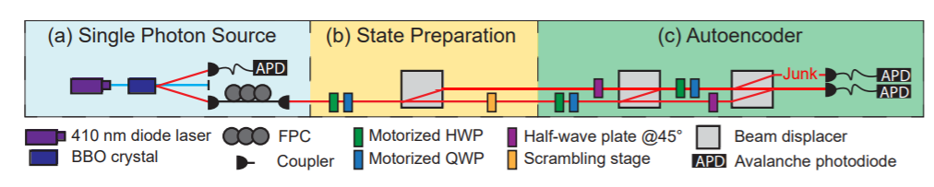

CQAE
[3]
Zhang Zeyu

Slide 10
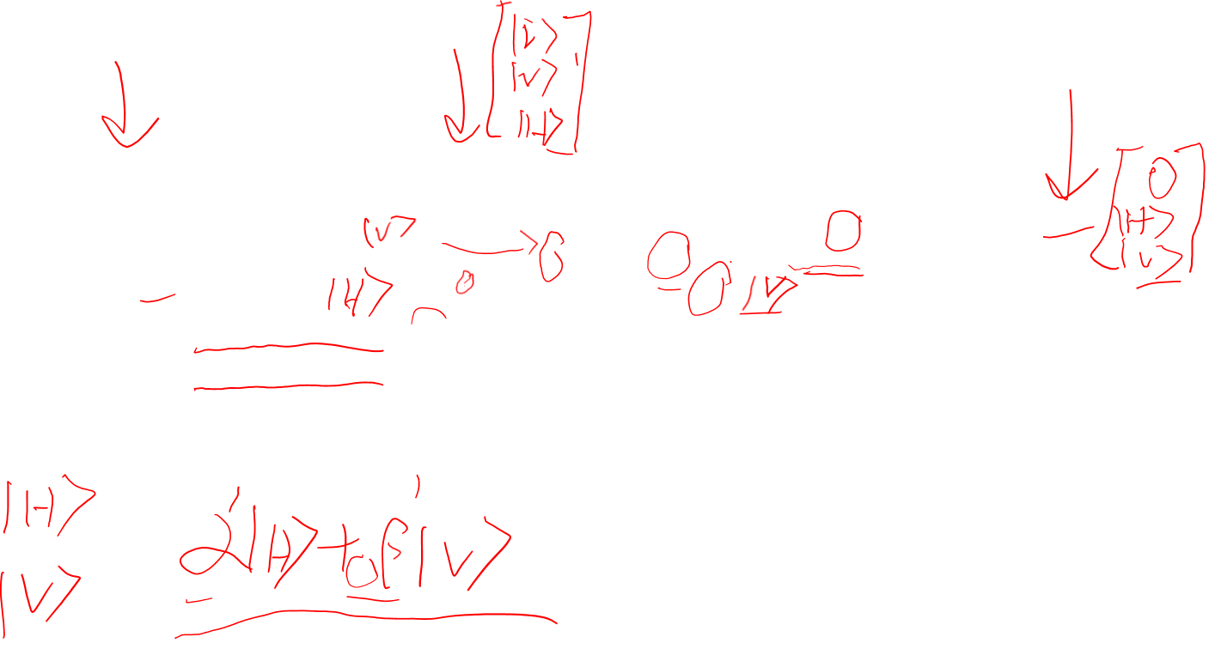
CQAE
[3]
Zhang Zeyu

Slide 11
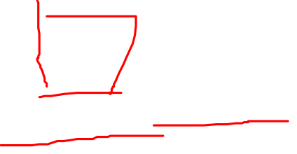
CQAE
[3]
Zhang Zeyu

Slide 12

CQAE
[3]
Zhang Zeyu

Slide 13

CQAE
[3]
Zhang Zeyu

Slide 14
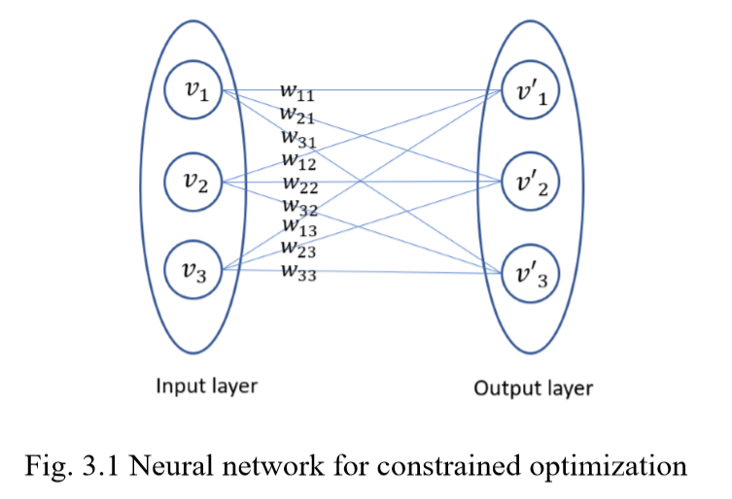
CQAE
Zhang Zeyu

Slide 15
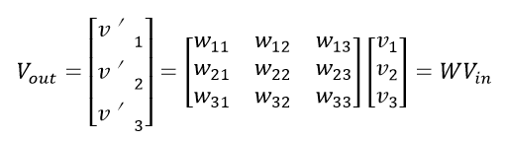

CQAE
Zhang Zeyu

Slide 16
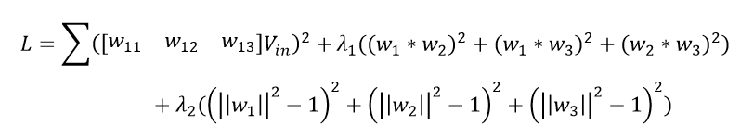

CQAE
Zhang Zeyu

Slide 17
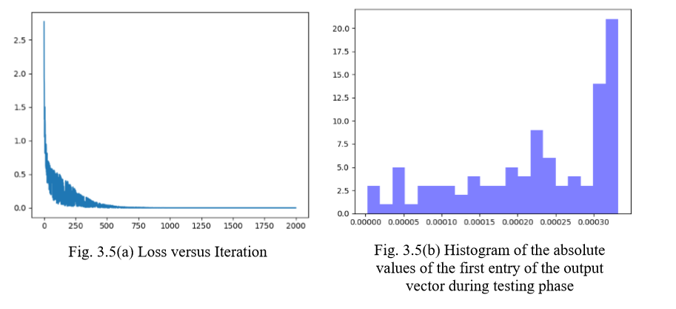

CQAE Real-space Gradient Descent
Zhang Zeyu

Slide 18
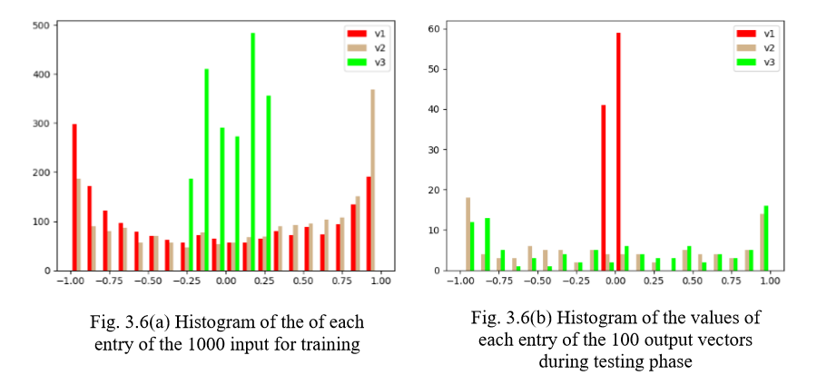

CQAE Real-space Gradient Descent
Zhang Zeyu

Slide 19
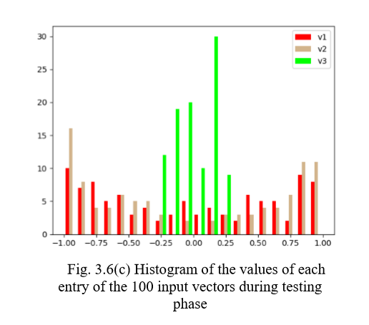
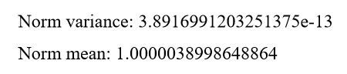

CQAE Real-space Gradient Descent
Zhang Zeyu

Slide 20
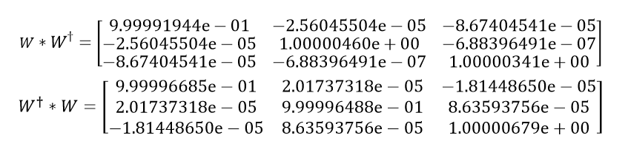

CQAE Real-space Gradient Descent
Zhang Zeyu

Slide 21
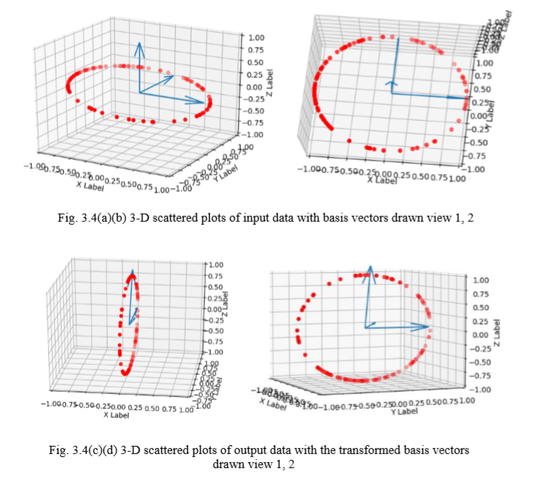

CQAE Real-space Gradient Descent
The ‘uniform transformation’ I mistakenly said should be ‘unitary transformation’ instead
Zhang Zeyu

Slide 22

CQAE Real-space Gradient Descent
Zhang Zeyu

Slide 23
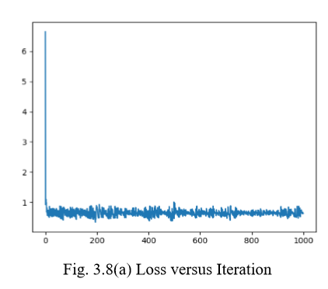
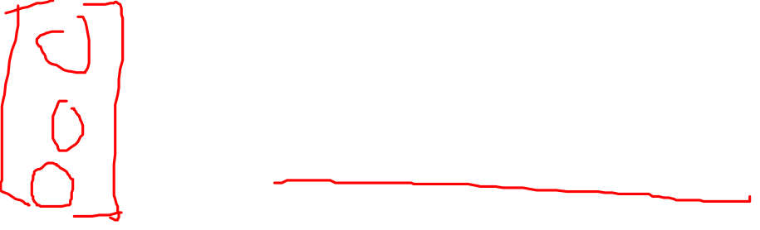
CQAE Complex-space Gradient Descent
Zhang Zeyu

Slide 24
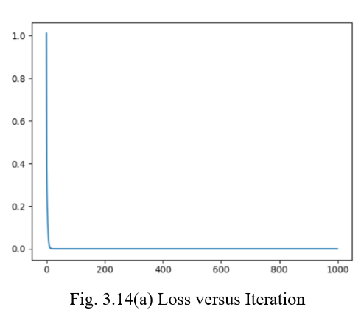
CQAE Complex-space Gradient Descent
Zhang Zeyu

Slide 25
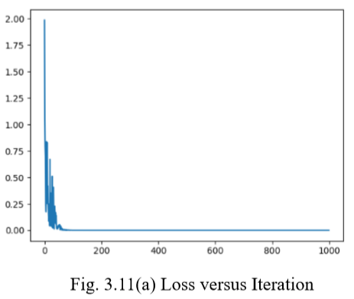

CQAE Complex-space Gradient Descent
Zhang Zeyu

Slide 26
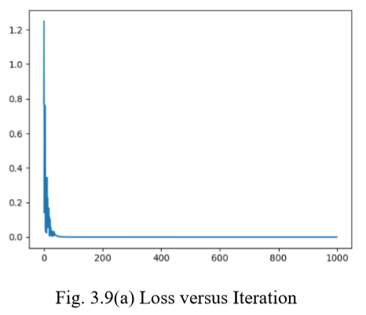

CQAE Complex-space Gradient Descent
Zhang Zeyu

Slide 27
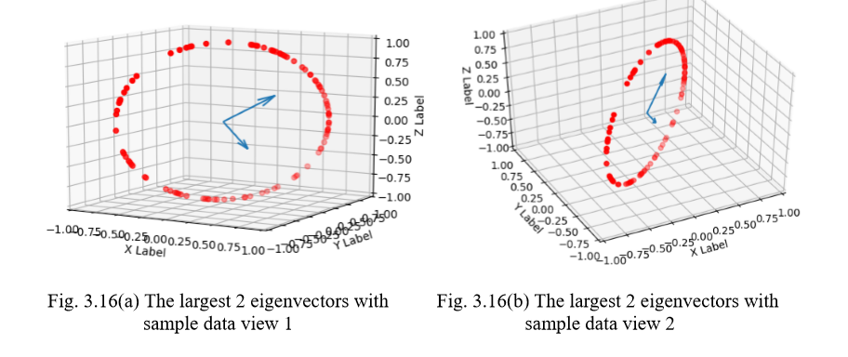
CQAE Principal Component Analysis
Zhang Zeyu

Slide 28
Background
CC: Classical Machine Learning
Classical-Quantum (CQ) Machine Learning : exploit quantum algorithms to speed up classical machine learning tasks
Quantum-Classical (QC) Machine Learning : exploit classical machine learning techniques to improve quantum tasks
Quantum-Quantum (QQ) Machine Learning : exploit quantum computing devices to carry out learning tasks with quantum data
Zhang Zeyu

Slide 29
Part 2: Quantum Denoising Autoencoder (QDAE)
Zhang Zeyu

Slide 30
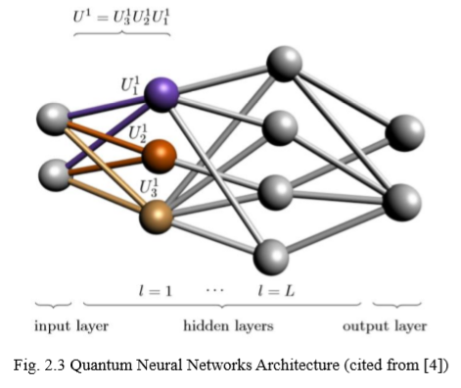
QDAE
Zhang Zeyu

Slide 31
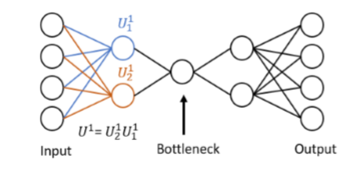
QDAE
[5]
Zhang Zeyu

Slide 32
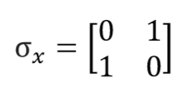
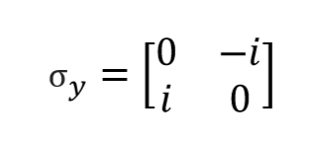
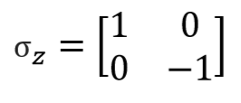
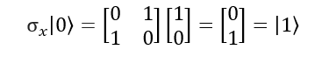

QDAE Noise Type
Zhang Zeyu

Slide 33
QDAE
[5]
Zhang Zeyu

Slide 34

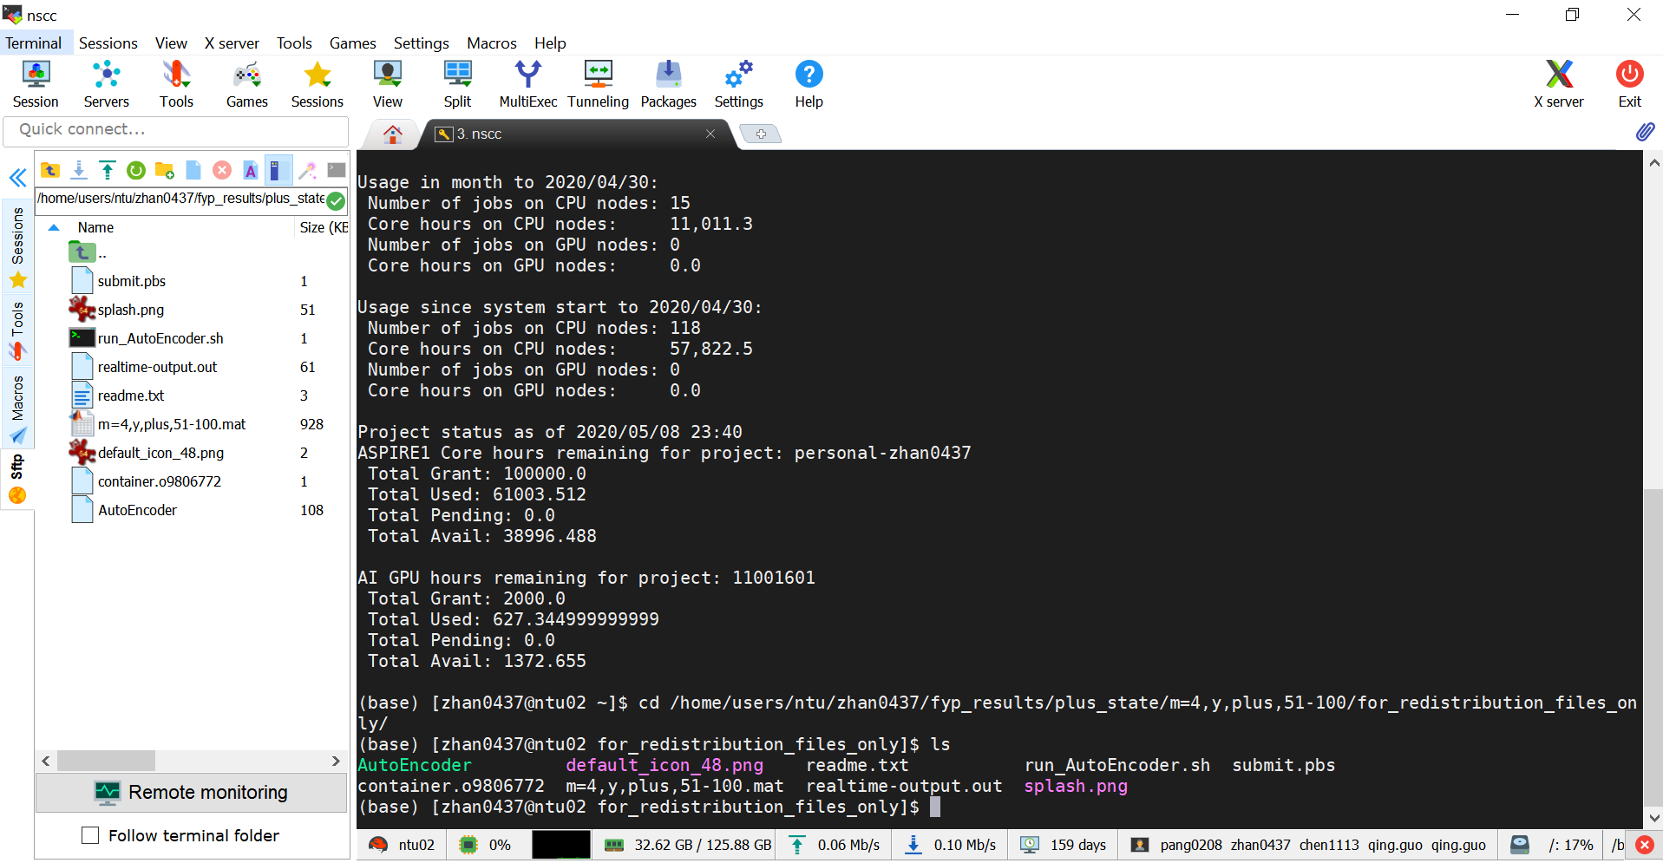
QDAE
Zhang Zeyu

Slide 35
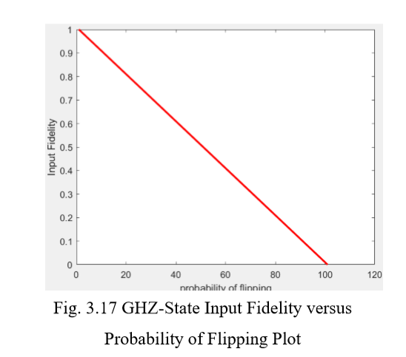

QDAE
Zhang Zeyu

Slide 36
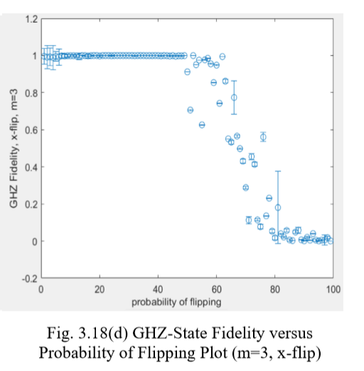
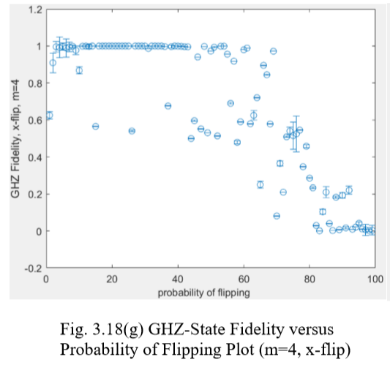

QDAE
Zhang Zeyu

Slide 37
QDAE
State type: GHZ state, W state,
Noise type: x-flip, y-flip, z-flip
Training/Testing
Plus state, Zero state
Zhang Zeyu

Slide 38
Reference
[1] Wikipedia (2020). Quantum machine learning. Retrieved from https://en.wikipedia.org/wiki/Quantum_machine_learning 9 May 2020.
[2] Tch, A. (2017). The Mostly Complete Chart of Neural Networks, Explained. Retrieved from https://towardsdatascience.com/the-mostly-complete-chart-of-neural-networks-explained-3fb6f2367464 9 May 2020.
[3] Pepper, A., Tischler, N., and Pryde, G.J. (2019). "Experimental realization of a quantum Autoencoder: The compression of qutrits via machine learning. " Phys. Rev. Lett., 122, 060501.
[4] Beer, K., Bondarenko, D., Farrelly, T., Osborne, T., Salzmann, R., and Wolf, R. (2019). "Efficient learning for deep quantum neural networks." arXiv preprint arXiv:1902.10445.
[5] Bondarenko, D., and Feldmann, P. (2020). "Quantum autoencoders to denoise quantum data." Physical Review Letters 124 (13): 130502.
Zhang Zeyu

